Slide 1


Marketing Meeting :
Business Plan

Slide 2

Summary
Market and Environment
Competition
Our products
The company
Team and planning
Equipement – property - wages
Company Strategy
Financial Aspects

Slide 3
The Logistics Market
It represents 710 Billion € = 8 % of European GDP, half is « out sourced »
France = 120 Billion € (15% - 3rd place in Europe)
1st in « Entrepots » rank because of the cheap rent
The market grows up 10% each year
Road transport « segment », the leader, with number of companies and it’s 1/2 of the French market (60 Billion €)
13 000 big companies and 28 000 small companies
« France is an attractive market »

Slide 4
Competition
ARP + ERP + MES + WMS = Perfect IT solution
More than 80% of the companies developped a specific solution
SCE : MES, WMS, TMS
SCE “part de marché” : 71% others, 8% SAP, 6% Manhattan Associates, … = “fragmented sector”
Companies need information in real time with tracking / tracing
A lot of different competitors with different solutions
« Hard competition »

Slide 5
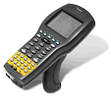
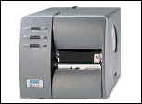
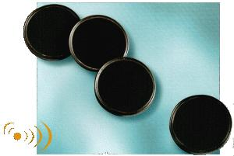
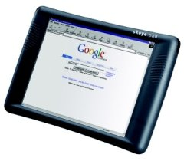
Offer : Our Modules
Presentation of the main modules :
  TransTec Flow
  TransTec Suite
Other modules :
  Tracking (website) / Tracing (GPS),
  RFID,
  Specific developpement,
  Training,
  Hotline, …
A commercial partner on RFID, GPS solutions, …
« Each module offers a specific solution »

Slide 6
Team – Planning :
Team :
  Development team :
    Project Manager
    Quality Manager
    Marketing Director
    4 Developpers
  Sales team :
    2 salesmen + 2 trainees during the 2nd year
    4 salesmen + 2 trainees from the 3rd year
Planning :
  Phase 1 : set up (1 month)
  Phase 2 : Prototype development (5 months)
  Phase 3 : Full development (1 year)
  Phase 4 : Test and integration with our products (2 months)
« Good Team & Planning = Good Results »

Slide 7
Company Strategy :
Corporate identity : Logos & Company Name
Marketing Campaign oriented B to B:
  Events (ex : SITL, Progilog, …)
  Printed media (ex : Le Transporteur, Stratégie Logistique, …)
  Website (will be showed during the software presentation)
  Direct Marketing (Mailing, Flyers, …)
Evolution and cost of the campaign
« Marketing, the best way to integrate the IT logistics market »

Slide 8
The company :
SARL with 7 500 € of capital for a limited responsability
Our goals :
  - Create a good SCE software
  Become a good commercial partner (RFID, GPS, …)
  Offer the latest technologies to our clients
Our office(s) :
  First in a « Zone Franche » in the East France(Reims)
  Maybe a 2nd office in Bavaria to target the Eastern Europe
« An innovative company on an attractive market »

Slide 9
Financial Aspects
Expenses :
  Furniture & IT equipment : 30 600 € (first year)
  Softwares : 13 300 € (per year)
  Rent : 13 750 € (per year)
  Wages : 250 k€ (first year), 310 k€ (2nd) and 360 k€ then
  Marketing : 200 k€ (2nd) and 150k€ (1st and after)
Funds :
  900 k€ for the first year and half
  500 to 800 k€ then
« Good investments for more benefice »

Slide 10
Financial Aspects
Incomes :
  Small businesses income average : 10 500 €
  Big businesses income average : 40 000 €
Sales :
  Small businesses : 25 (2nd year) and 45 (3rd year)
  Big businesses : 15 (2nd year) and 35 (3rd year)
Rentability zero :
  After 18 months
« Good perspectives for our business »

Slide 11
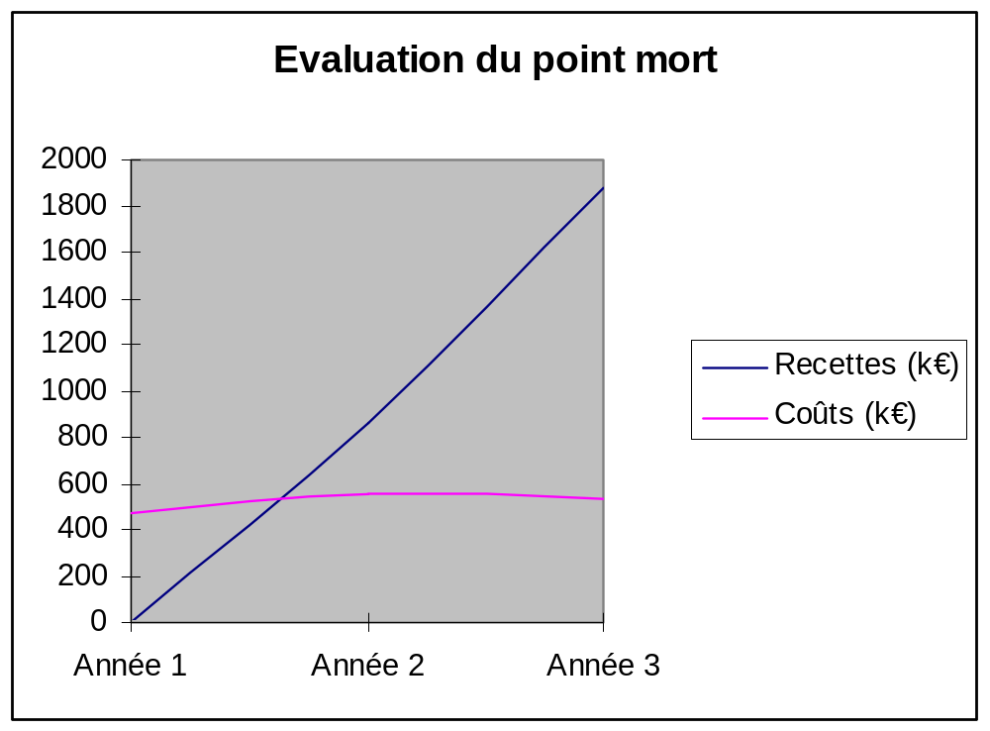
Financial Aspects
« Good perspectives for our business »

Slide 12
Any questions ?

